Slide 1

SDP END-TERM EVALUATION
A CNN model with attention designed for Histopathological
breast cancer image classification with minimal overhead
Supervised By: Dr. Dibyasundar Das
Group No.C2:
Bishal Ranjan Ray [2041018088]
Priyabrata Biswal [2041002133]
Sangram Jyotiprakash Giri [2041007019]
Adarsha Mohapatra [2041013206]
Department of Computer Sc. and Engineering
Faculty of Engineering & Technology (ITER)
Siksha ‘O’ Anusandhan (Deemed to be) University
Bhubaneswar, Odisha
‹#›

Slide 2
Presentation Outline
Introduction
Overview
Motivations
Uniqueness of the work
Literature Survey
Existing System
Problem Identification
Model Diagram
Methods and Tools
Experimentation and Results
Model Specifications
Datasets Description
Parameters used
Experimental outcomes
Result Analysis and Validation
Conclusion and Future Scope
Bibliography
‹#›

Slide 3
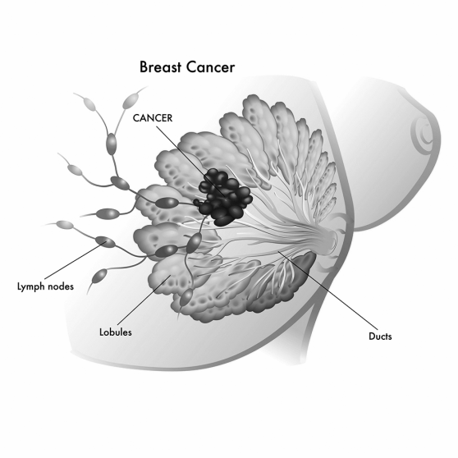
Introduction
Overview
Breast cancer is a type of cancer that originates in the cells of the breast. It occurs when mutations in breast cells cause them to grow uncontrollably and form a tumor.
The tumor can be benign (non-cancerous) or malignant (cancerous), and later on it causes the Cancer.
There are some methods to diagnosis the breast cancer i.e.
Mammogram
Breast MRI
CT Scan
Histopathological image classification
A histopathological image is a visual representation of tissue samples examined under a microscope to study the microscopic structure of tissues and cells.
Figure 1: Breast with cancerous tissue
‹#›

Slide 4
Introduction contd..
Motivations
Now Breast Cancer is a Global Health Concern. Despite advancements in treatment, mortality rates remain high, emphasizing the importance of early detection.
Overdiagnosis and misdiagnosis are concerns in breast cancer diagnosis.
Histopathological analysis is the current gold standard for cancer diagnosis, including breast cancer.
There is a growing need for Computer-Assisted Diagnosis(CAD) systems to assist pathologists in diagnosing breast cancer.
The project aims to develop a computationally efficient convolutional neural network (CNN) with an attention-based mechanism to improve diagnosis efficiency and accuracy.

Slide 5
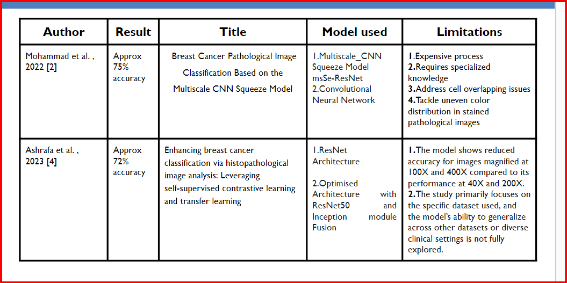
Literature Survey
Existing System for Breast Cancer Detection
‹#›

Slide 6
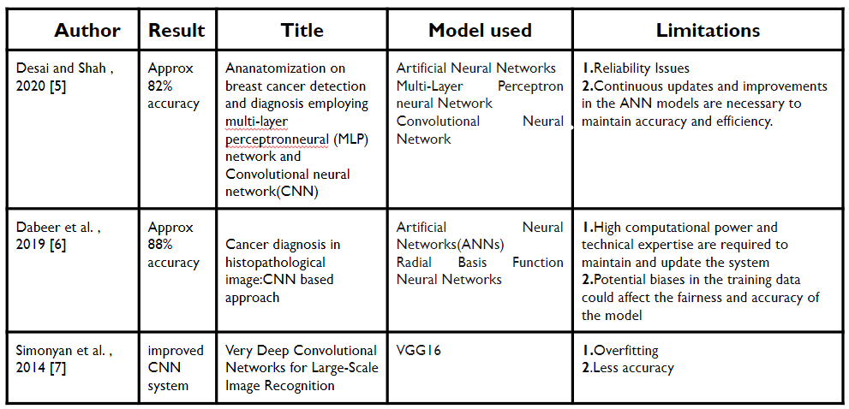
Literature Survey Contd..
‹#›

Slide 7
Literature Survey Contd..
Problem Identification
Limitations of Traditional Methods:
Mammography:
Reduced sensitivity in dense breast tissue.
False positives leading to unnecessary biopsies.
Ultrasound and MRI:
High cost and limited accessibility.
Requires skilled technicians and radiologists.

Slide 8
Literature Survey Contd..
Problem Identification
Challenges with AI-Based Systems:
Generalization:
Difficulty in generalizing to diverse populations.
Risk of overfitting to specific datasets.
Interpretability:
Challenges in understanding decision-making process.

Slide 9
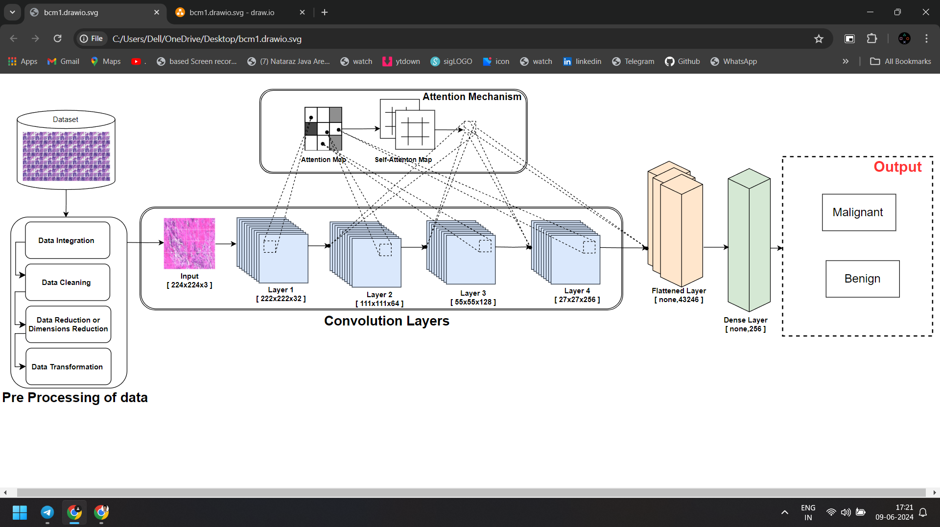
Model Diagram
Figure 2 : Model diagram for Breast Cancer Detection
‹#›

Slide 10
Methods and Tools
Methods:
Data Collection and Preprocessing
Image Augmentation: Rotation, flip, shear, zoom.
Data Splitting
Model Creation
Convolutional Neural Network (CNN) architecture.
Attention Mechanism in CNN.
Training and Evaluation
Tools:
Python Libraries: numpy, pandas, matplotlib, seaborn, sklearn, os, shutil, cv2, tensorflow
Google Colab and Google Drive
‹#›

Slide 11
Methods and Tools Contd..
Deep Learning Frameworks:
TensorFlow:
Developed by Google
Open-source machine learning framework
Supports neural networks, reinforcement learning, etc.
Keras:
High-level neural network API
User-friendly, modular, and extensible
Integrates with TensorFlow for deep learning tasks
‹#›

Slide 12
Experimentation and Results
Model Specifications/Architecture
Layers:
Input Layer: 224x224 RGB Images.
Convolutional Layers:
4 layers (64, 128, 256, 512 filters)
MaxPooling Layers: After each convolutional layer
Dropout Layers: 0.5 dropout after pooling layers
Attention mechanism:
Conv2D (1x1) with sigmoid activation for attention weights
Multiply layer for applying attention to feature maps

Slide 13
Experimentation and Results Contd..
Model Specifications/Architecture
Layers Contd..:
Flatten Layer: Flattens the multi-dimensional output into 1D Vector
Dense Layers:
Dense with 512 neurons, RELU activation, L2 regularisation(0.01)
Dropout (0.5)
Dense with 256 neurons, RELU activation, L2 regularisation(0.01)
Output Layer: Dense with 1 neuron, sigmoid activation for binary classification
Optimizer: Adam optimizer with InverseTimeDecay learning rate scheduler.
Loss Function: Binary Crossentropy.

Slide 14
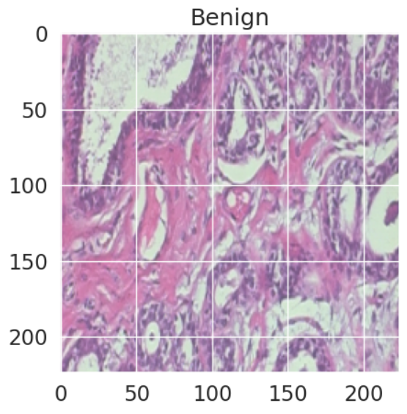
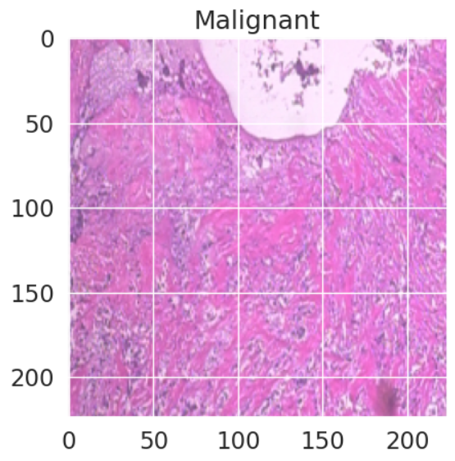
Experimentation and Results Contd..
Datasets Description
The Breast Cancer Histopathological Image Classification (BreakHis) is composed of 7,909 microscopic images of breast tumor tissue.
The images are collected using different magnifying factors (40X, 100X, 200X, and 400X). To date, it contains 2,480 benign and 5,429 malignant samples (700X460 pixels, 3-channel RGB, 8-bit depth in each channel, PNG format).
Figure 3 : Image samples from BreakHis Dataset

Slide 15
Experimentation and Results Contd..
Parameters used
The parameters used in the project can be categorised into 2 parts:
Image Data Generator Parameters: rotation_range: 20 degrees horizontal_flip: True vertical_flip: True shear_range: 0.2 fill_mode: Nearest zoom_range: 0.2 | Model Training Parameters: Batch Size: 32 Epochs: 100 Learning Rate: 0.0001 Class Weights: Computed for data imbalance

Slide 16
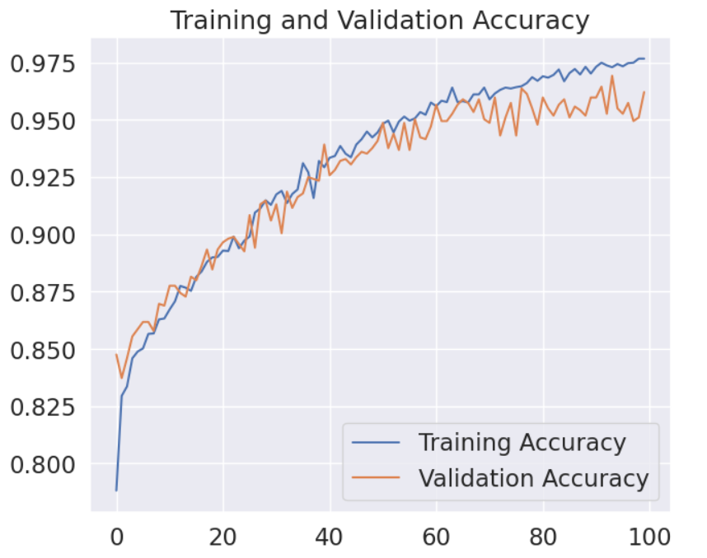
Experimentation and Results Contd..
Experimental outcomes (Tables and Figures)
Figure 4 :
 | The left plot shows the accuracy of the model on both training and validation datasets over epochs. The increase in accuracy over time indicates the model is learning effectively. The validation accuracy helps monitor the model's performance on unseen data.
Accuracy
Number of Epochs

Slide 17
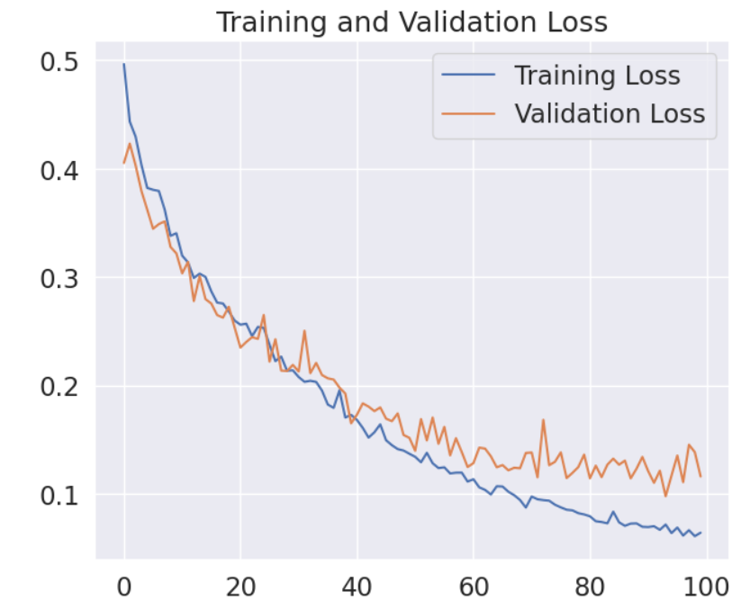
Experimentation and Results Contd..
Figure 1: Breast with cancerous tissue
Figure 5:
 | This plot illustrates the loss for training and validation datasets over epochs. A decreasing trend in both training and validation loss signifies effective learning. Monitoring both helps ensure the model isn't overfitting or underfitting.
A
c
c
u
r
a
c
y
Number of Epochs

Slide 18
Experimentation and Results Contd..
Result Analysis and Validation
Class | Accuracy | Precision | Recall | F1-score
Benign (0) | 0.95 | 0.91 | 0.91 | 0.91
Malignant(1) |  | 0.96 | 0.96 | 0.96
Macro Average | 0.93 | 0.94 | 0.94
Weighted Average | 0.95 | 0.95 | 0.95
Table 1: Classification report on testing

Slide 19
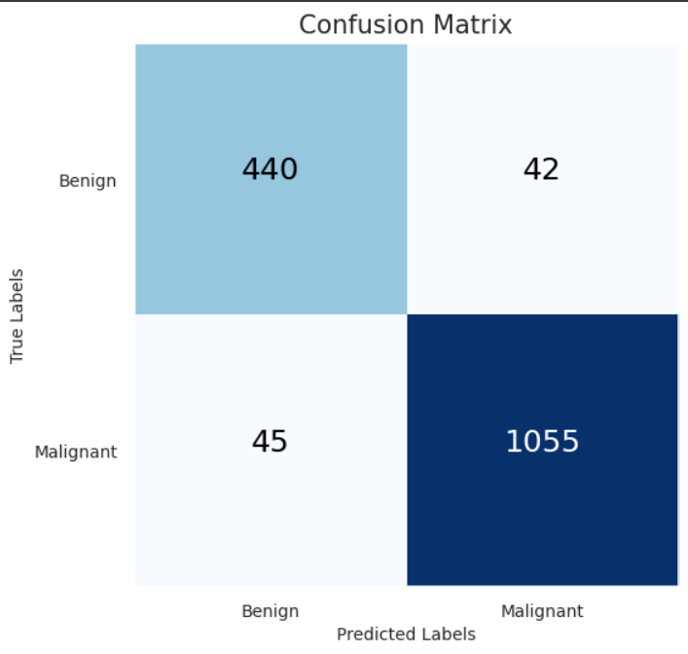
Experimentation and Results Contd..
Result Analysis and Validation
Figure 6 : Confusion Matrix

Slide 20
Result Analysis and Validation
Model | Accuracy | Precision | Recall | Macro F1 | Weighted F1
VGG16 | 0.65 | 0.61 | 0.68 | 0.63 | 0.65
VGG19 | 0.69 | 0.64 | 0.58 | 0.58 | 0.67
RssNet152V2 | 0.8 | 0.79 | 0.82 | 0.8 | 0.8
InceptionV3 | 0.87 | 0.85 | 0.89 | 0.87 | 0.87
InceptionResNetV2 | 0.87 | 0.9 | 0.85 | 0.86 | 0.87
Xception | 0.89 | 0.9 | 0.9 | 0.9 | 0.89
CNN Model with attention Map | 0.95 | 0.96 | 0.95 | 0.94 | 0.95
Reference: (PDF) Comparative Analysis of Deep Learning Architectures for Breast Cancer Diagnosis Using the BreaKHis Dataset (researchgate.net)

Slide 21
Conclusion and Future Scope
Summary of Findings:
The proposed deep learning model with an attention mechanism shows significant improvements in distinguishing between benign and malignant breast cancer cases.
The model achieves high precision and recall, leading to better detection accuracy and fewer false positives.
‹#›

Slide 22
Conclusion and Future Scope Contd..
Advantages of the Proposed Model:
Improved Detection Accuracy:
The model provides better performance metrics compared to traditional methods and some existing AI-based systems.
High precision and recall rates ensure reliable results.
Enhanced Interpretability:
The attention mechanism allows for better understanding of the model's focus areas, making the decision-making process more transparent.
This can help radiologists understand and trust the AI's suggestions.
Cost-Effectiveness and Accessibility:
The model can be implemented on standard medical imaging equipment, making it more accessible.
Reduces the need for expensive molecular imaging techniques, lowering overall healthcare costs.
‹#›

Slide 23
Conclusion and Future Scope Contd..
Future Scope:
Further Enhancement of Accuracy and Performance Metrics:
Continuously strive to improve detection accuracy by refining the model architecture, optimizing hyperparameters, and incorporating larger and more diverse datasets.
Explore ensemble methods or multi-modal approaches to leverage complementary information sources and enhance overall performance metrics such as sensitivity, specificity, and F1-score.
Cost-Effectiveness and Accessibility:
Conduct economic evaluations and cost-effectiveness analyses to quantify the financial benefits of implementing your model compared to traditional methods or other AI-based systems.
Work on making the model more accessible by optimizing computational resources and ensuring compatibility with a wide range of medical imaging equipment and facilities.
‹#›

Slide 24
Bibliography
F. A. Spanhol, L. S. Oliveira, C. Petitjean, and L. Heutte, “A Dataset for Breast Cancer Histopathological Image Classification,” IEEE Trans. Biomed. Eng., vol. 63, no. 7, pp. 1455–1462, Jul. 2016.
Y. Alqahtani, U. Mandawkar, A. Sharma, M. N. S. Hasan, M. H. Kulkarni, and R. Sugumar, “Breast Cancer Pathological Image Classification Based on the Multiscale CNN Squeeze Model,” Computational Intelligence and Neuroscience, vol. 2022, pp. 1–11, Aug. 2022.
S. M. Thwin, S. J. Malebary, A. W. Abulfaraj, and H.-S. Park, “Attention-Based Ensemble Network for Effective Breast Cancer Classification over Benchmarks,” Technologies, vol. 12, no. 2, p. 16, Jan. 2024.
F. B. Ashraf, S. M. M. Alam, and S. M. Sakib, “Enhancing breast cancer classification via histopathological image analysis: Leveraging self-supervised contrastive learning and transfer learning,” Heliyon, vol. 10, no. 2, p. e24094, Jan. 2024.
M. Desai and M. Shah, “An anatomization on breast cancer detection and diagnosis employing multi-layer perceptron neural network (MLP) and Convolutional neural network (CNN),” Clinical eHealth, vol. 4, pp. 1–11, 2021.
S. Dabeer, M. M. Khan, and S. Islam, “Cancer diagnosis in histopathological image: CNN based approach,” Informatics in Medicine Unlocked, vol. 16, p. 100231, 2019.

Slide 25

‹#›

